Slide 1
“ MICROSOFT AZURE ”
“ How to create an account in Microsoft Azure ”
By : Sagar F Honnabindagi

Slide 2
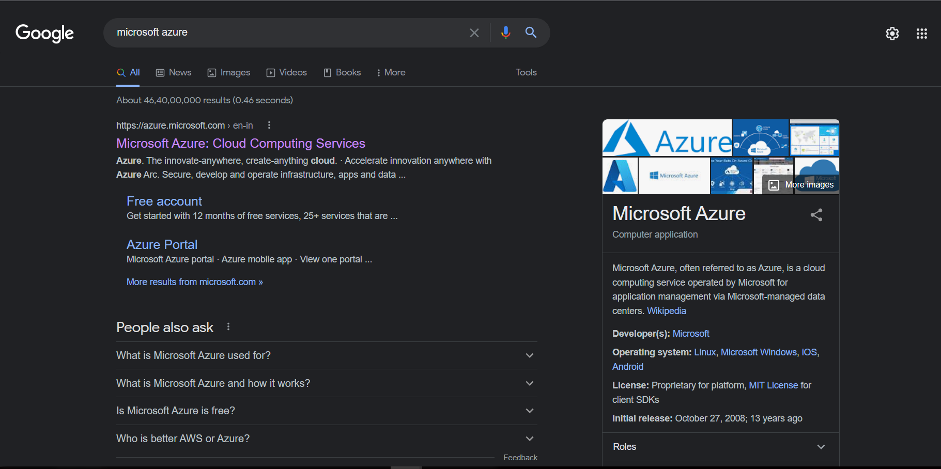
1.Open Browser and Search Microsoft Azure

Slide 3
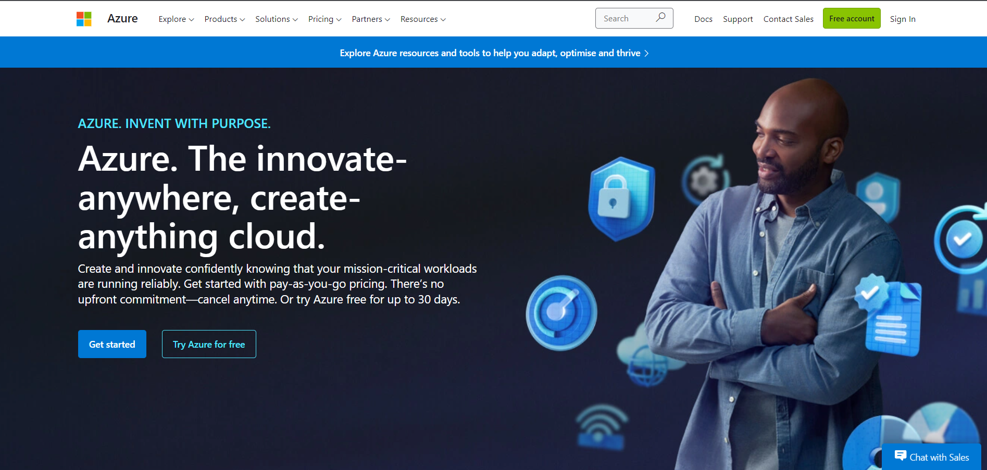
2. Official Webpage of Microsoft Azure

Slide 4
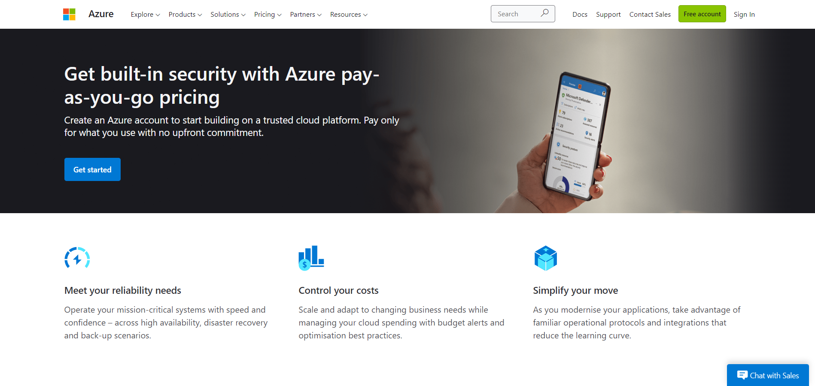
3.Get Started

Slide 5
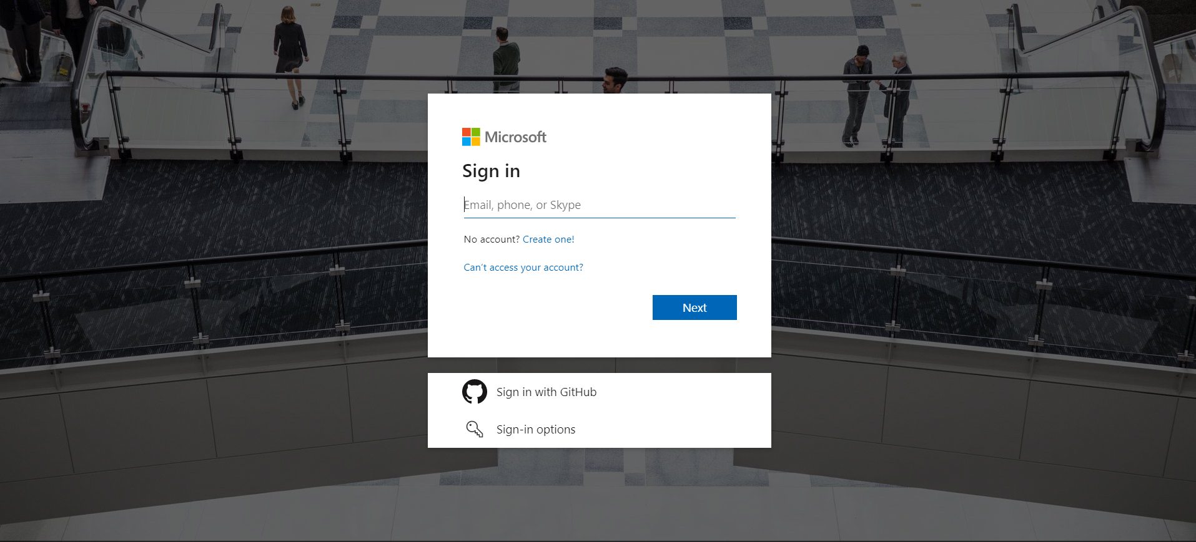
4.Sign-in Page

Slide 6
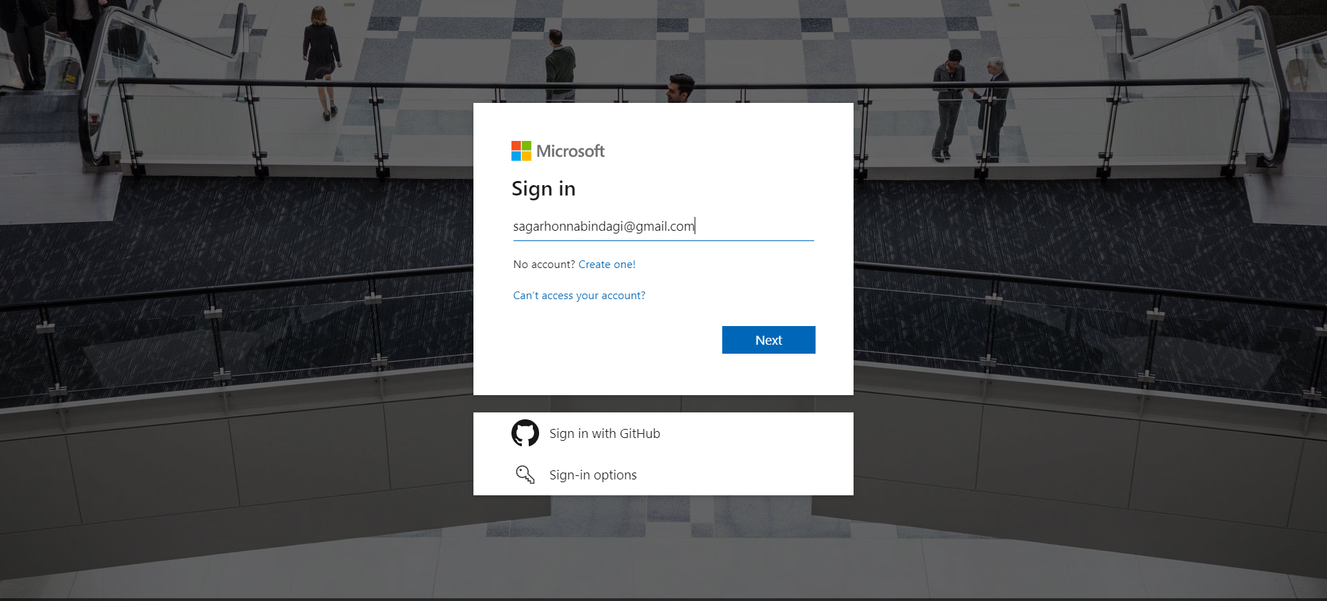
5.Adding Details to Login

Slide 7
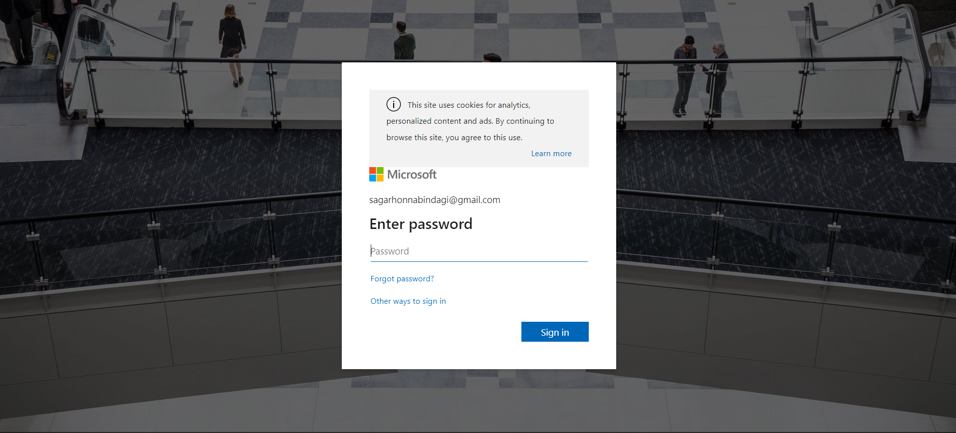
6.Adding Password

Slide 8
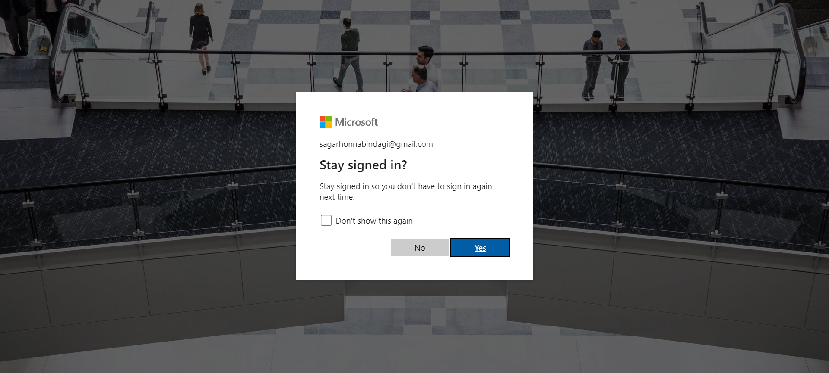
7.Stay signed in option

Slide 9
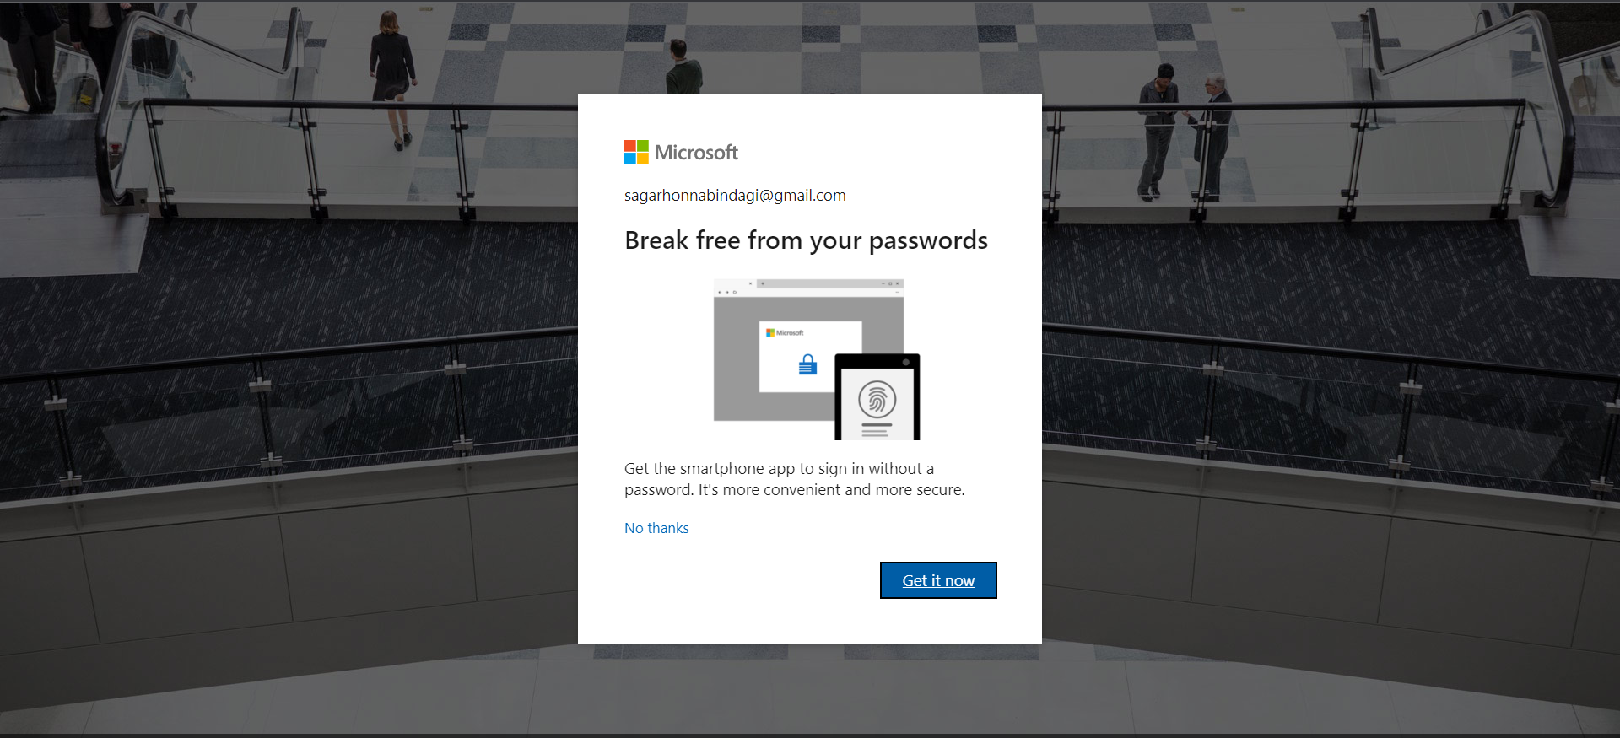
8.Password free setup

Slide 10
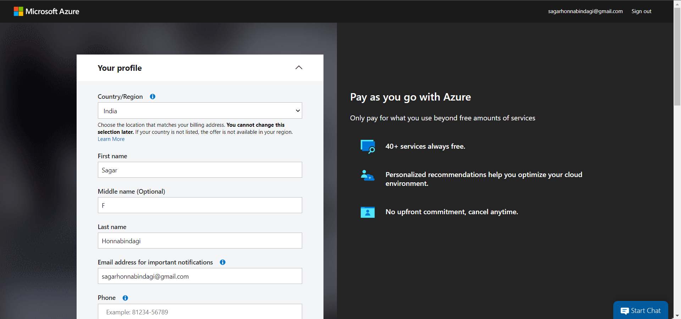
9.Adding personal details of user

Slide 11
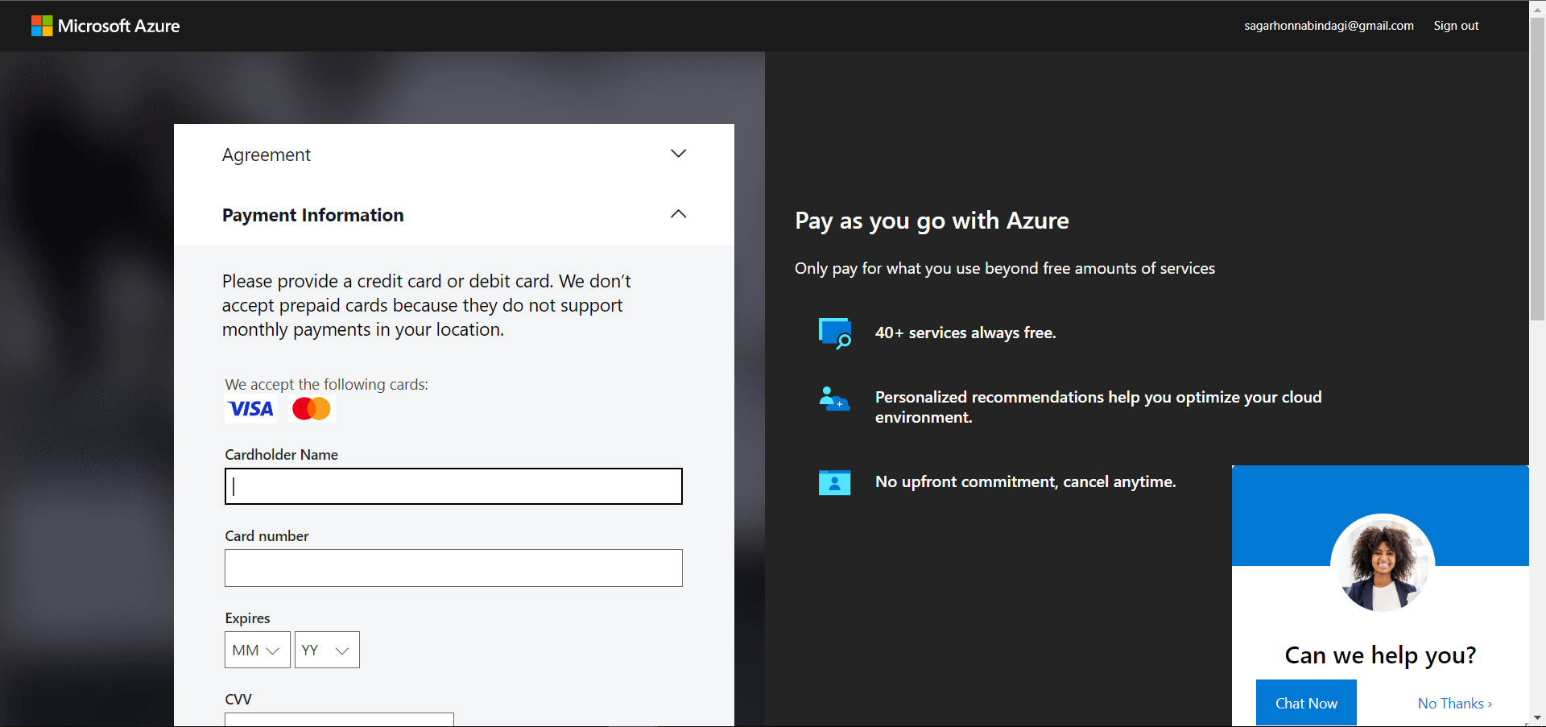
9.Adding card details for payment

Slide 12


